Slide 1
Introduction to Pytorch

Slide 2
Road Map
What is Pytorch
Building Models with Pytorch
Training and Testing Models with Pytorch

Slide 3
What is Pytorch?

Slide 4
Pytorch
Pytorch is
A python library designed specifically for building and training deep neural networks
Building computational graphs
Automatic differentiation
Designed to perform the arithmetic operations common in ML optimally on both CPU and GPU
Tensor operations based on linear algebra and matrix theory
Built to be flexible so that as the field of ML matures, Pytorch should remain relevant
Commonly used in both research and industry
For more information refer to the Pytorch examples and docs

Slide 5
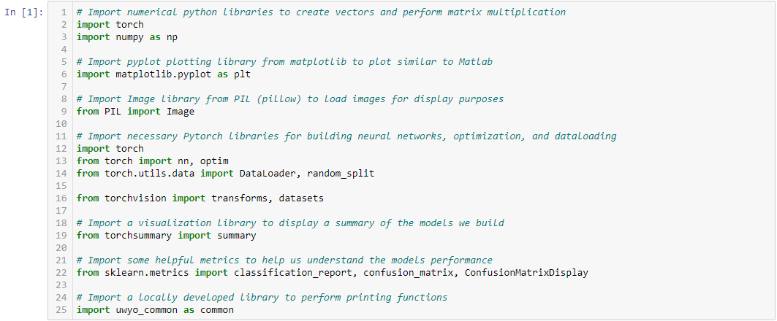
Import Pytorch

Slide 6
Building Models with Pytorch

Slide 7
Model Construction Paradigms
Construction using a class allows you to:
Define your own layers, loss functions, and optimizers
You must provide both forward and backward functions to define what happens when an input is received and how to backprop results
Construction using an object allows you to:
Get started quickly with less technical knowledge
Create many different networks quickly using the provided layers, loss functions, and optimizers
We will be using the model approach as it is less complex

Slide 8
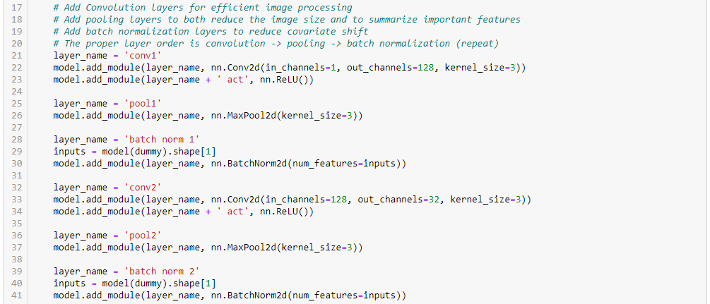
Model Construction

Slide 9
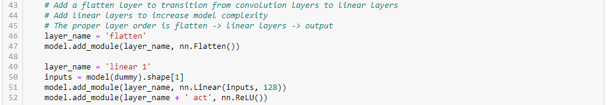
Model Construction

Slide 10
Training and Testing Models with Pytorch

Slide 11
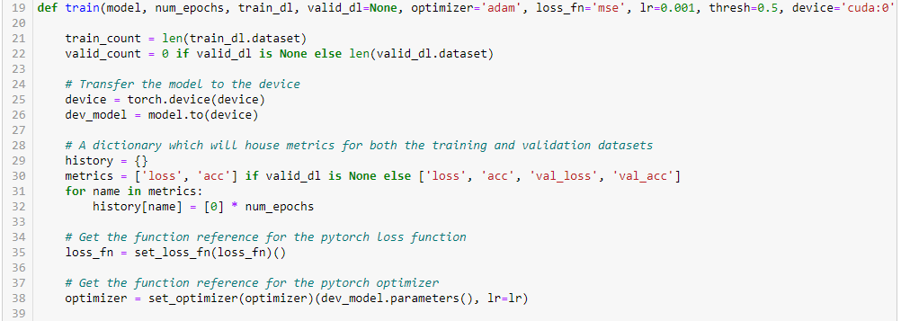
Training Models with Pytorch

Slide 12
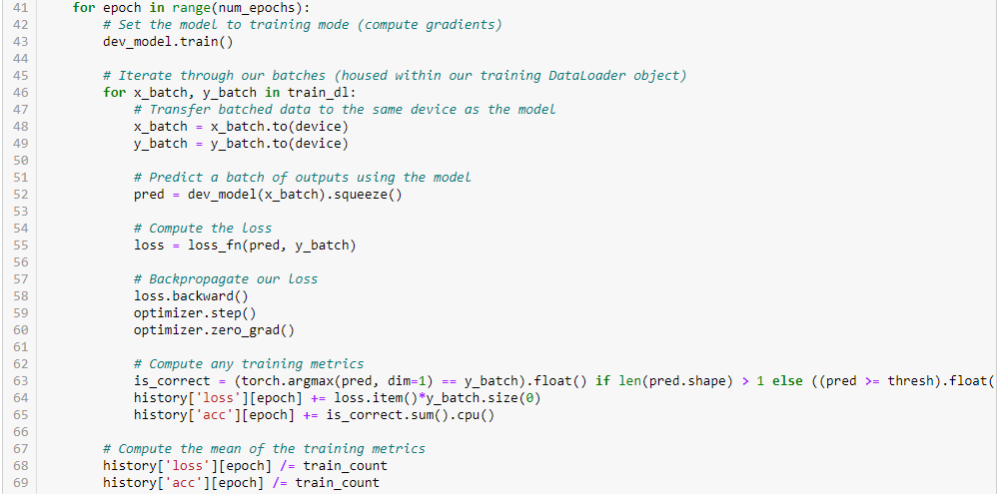
Training Models with Pytorch

Slide 13
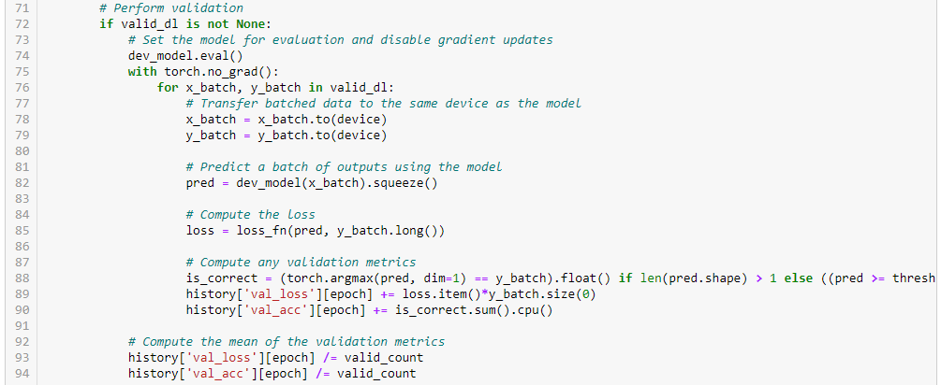
Training Models with Pytorch

Slide 14
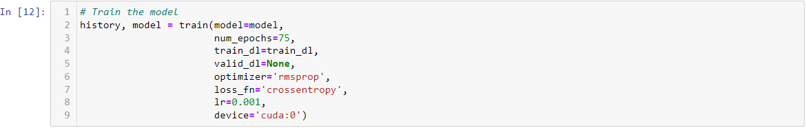
Training Models with Pytorch

Slide 15
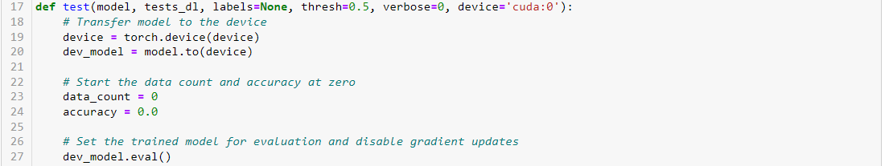
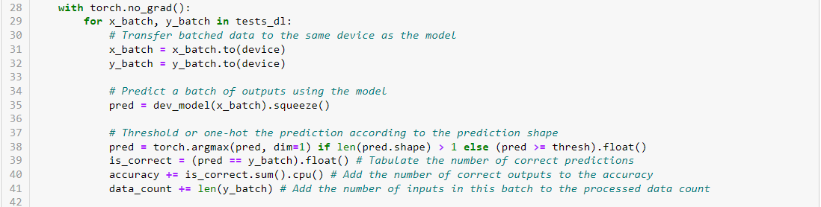
Testing Models with Pytorch

